Slide 1
Non-Standard Infinite Sums
(Warning: not for answering questions
on the AP Calculus Exam)
(definitely for fans of Srinivasa Ramanujan, Euler, Riemann Zeta Function,
String (M) theory, ...)
Chris Thiel, OFMCap
2016

Slide 2
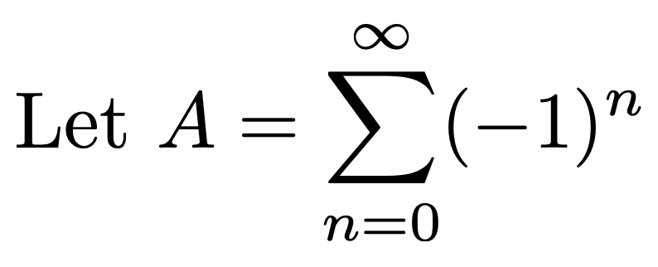
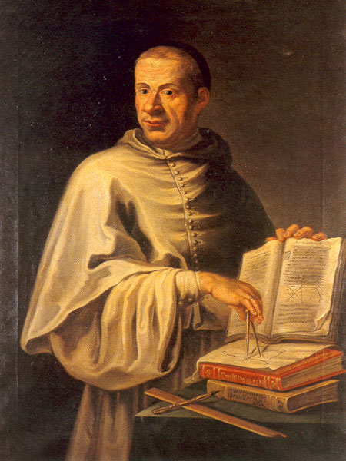



Dom Luigi Guido Grandi, OSBCam 1671-1742

Slide 3
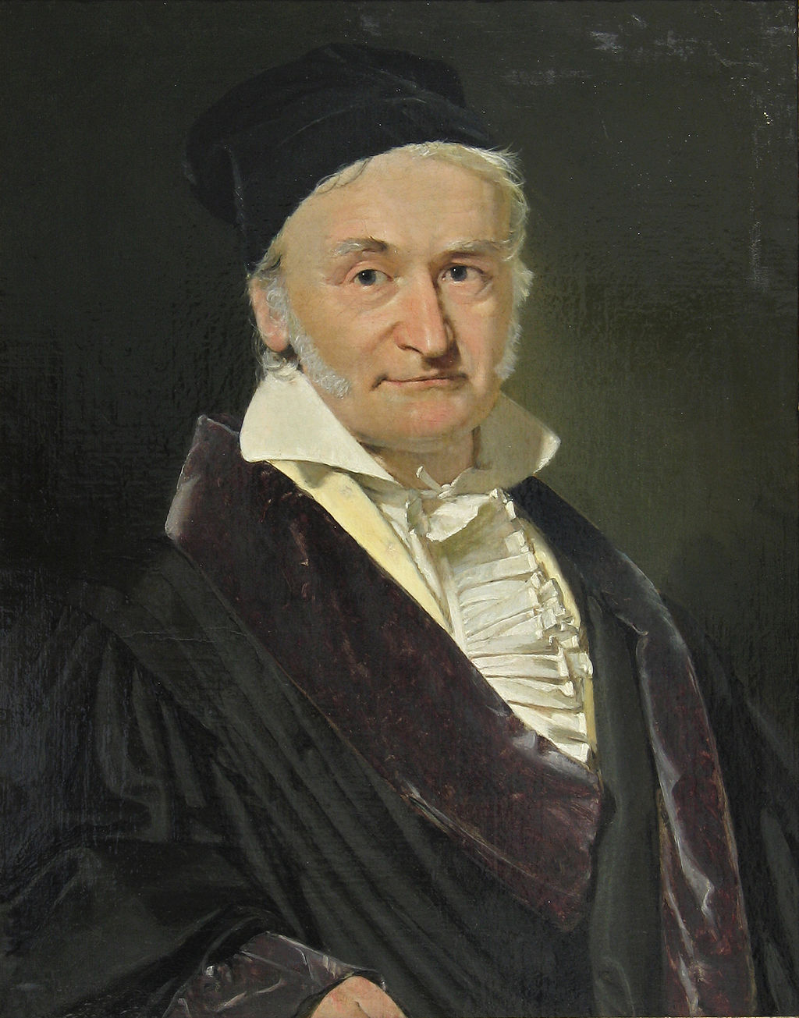

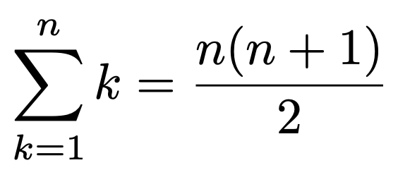


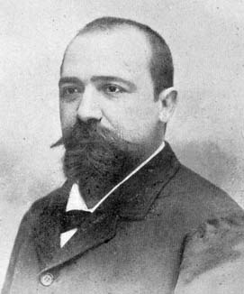

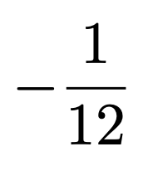
Adding the counting numbers
Karl Friedrik Gauß (1777-1855)
Ernesto Cesàro (1859-1906)
Cesàro Summation

Slide 4
